Slide 1
Sentiment Analysis
By Team EndGame

Slide 2
Problem Statement
Given a tweet, predict the sentiment reflected in it.
Predict whether sentiment portrayed is:
Negative
Neutral
Positive
Undecided (referred as can’t say)

Slide 3
Potential Business Problem
Using the analysed tweets to understand market standing of the product vis a vis the competition.
Understand impact of marketing strategies especially evangelism and word of mouth marketing.
Design effective marketing and sales promotion campaigns.
To help in product modification and product development strategies.
Potential Stakeholder:
Marketing Team
Product design Team

Slide 4
Data
This dataset contains around 7k tweet text with the sentiment label.
Data contains 3 columns
Tweet Id: Unique id for each tweet recorded. Essentially numeric.
Tweet : The given tweet by the user. Essentially textual in nature, with datatype object.
Sentiment : Target variable. Has 4 classes and is categorical in nature.
Classes present: 0: Negative, 1:Neutral, 2:Positive, 3:Can’t Say

Slide 5

Evaluation Metric
The evaluation metric for this problem statement is the F1- Score
F1 which is a function of Precision and Recall.
F1 Score might be a better measure to use if we need to seek a balance between Precision and Recall AND there is an uneven class distribution.

Slide 6
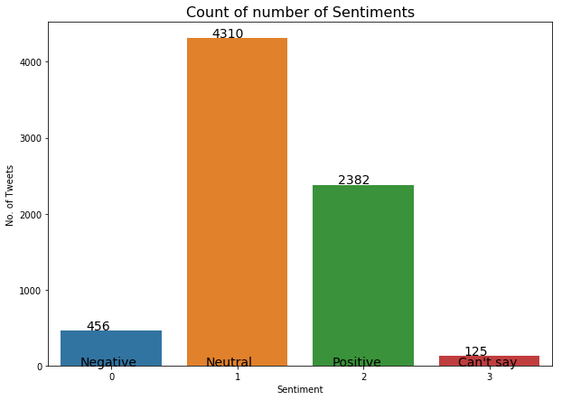
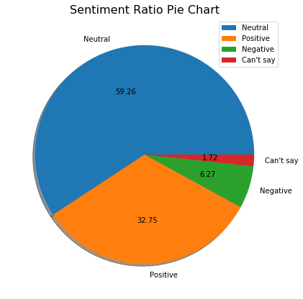
EDA - Target Variable
The target variable is the sentiment to be predicted which has 4 classes. The classes being 0:Negative, 1:Neutral, 2:Positive, 3:Can’t Say.
The classes are highly imbalanced as can be seen here:

Slide 7
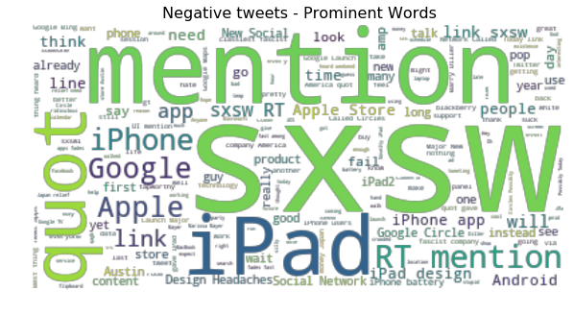
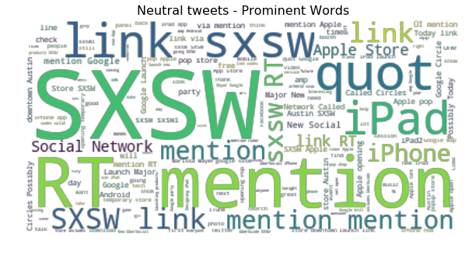
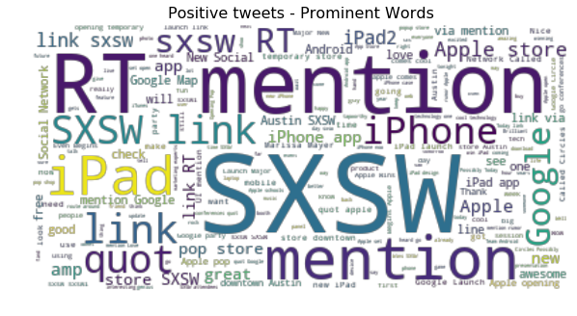
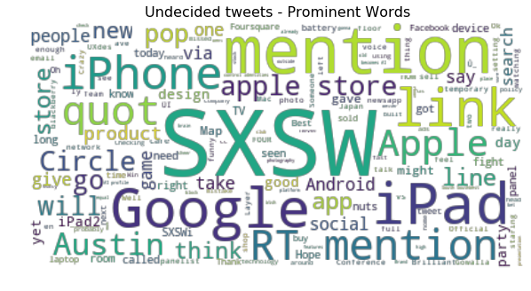
EDA – Input Variables
We visualized the words that belonged to each class of sentiment.
However from the word-clouds we can see that the same words like Google, link, RT, iPhone, Apple, SXSW appear in all kinds of text and therefore will provide hardly any predictive power.

Slide 8
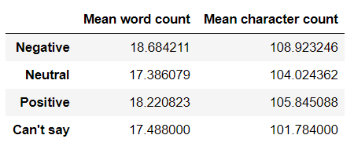
EDA – Input Variables
Checking for the number of characters in the given tweets. We found that
Maximum number of characters in the tweet 178
Minimum number of characters in the tweet 11
Checking this ensures, tweets are genuine since maximum character limit is 280 characters.
Also the following table represents the average number of words and characters in tweets as per sentiment

Slide 9
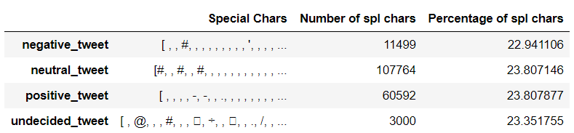
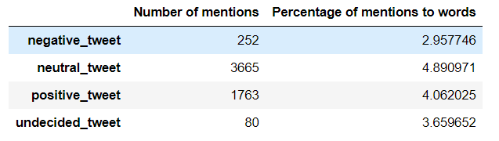
EDA – Input Variables
Similar analysis was conducted for each of the following points:
Special Characters in tweets
Mentions in tweets

Slide 10
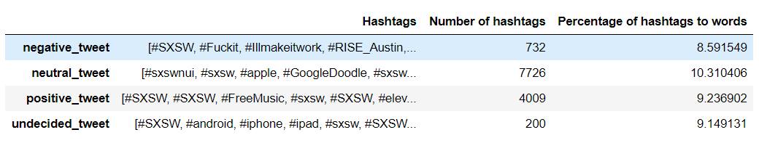
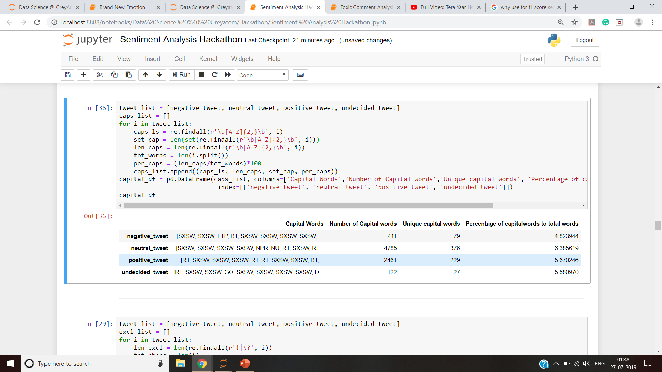
EDA – Input Variables
Hashtags in tweets
Capital words in tweets

Slide 11
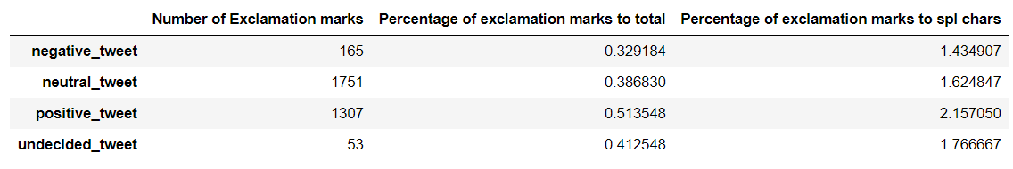
EDA – Input Variables
Exclamation in tweets

Slide 12
EDA – Input Variables
Special characters in each category
text_Negative has 8 and 0.09389671361502347% @ mention
text_Neutral has 104 and 0.13878880081138067% @ mention
text_Positive has 61 and 0.1405465185936132% @mention
text_Unknown has 2 and 0.09149130832570906% @mention
Positive and Neutral tweets have more number of @ menstion so count of @ mention can be important for prediction.

Slide 13
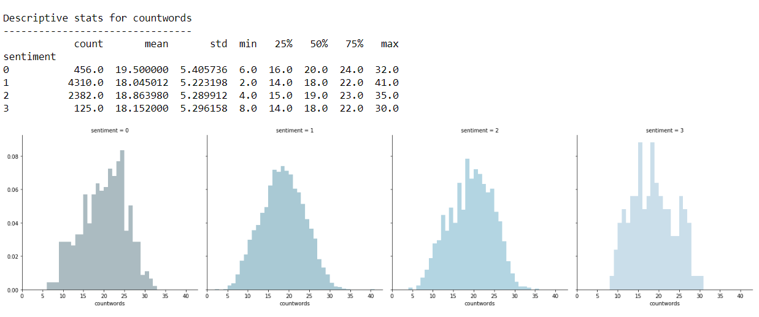
EDA – Input Variables
Charcount: character count
Countwords: count of words in the tweet
@counts: number of @mentions
#counts: number of #tags
Capscounts: number of Caps character
count_excl_quest_marks: count of question marks
count_urls: count of urls in the tweet
count_special_chars: count of special character in tweet
Company: bins
Descriptive stats for each newly created variables:

Slide 14
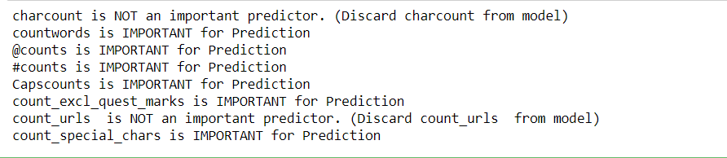
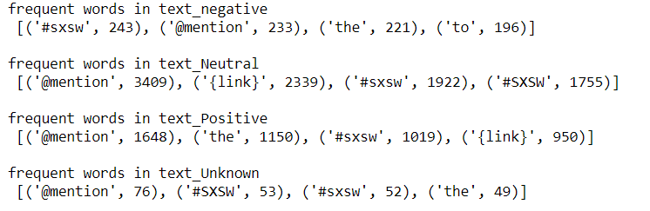
Chi square test results:
Frequent words in each category

Slide 15
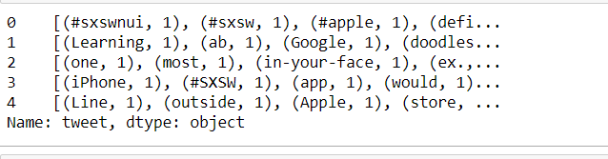
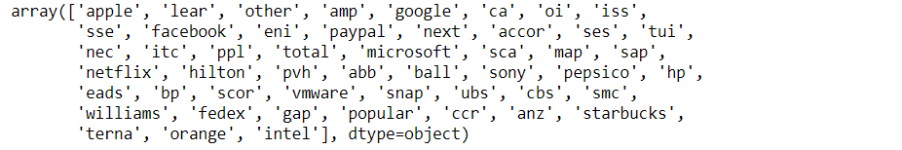
Top words in tweet without stop words
Unique bins:

Slide 16
Preprosessing
Removed @mentions and # tags, RT
Removed words less than 3
Tried lemmatization, stemming

Slide 17
What we tried
Model | Strategy | F1
Logistic regression | Random over sampling | 0.667
Logistic Regression | Random under sampling | 0.656
Random forest | Random over sampling | 0.56
Random forest | Random under sampling | 0.54
Linear SVC | Random over sampling | 0.52
Linear SVC | Random under sampling | 0.525

Slide 18
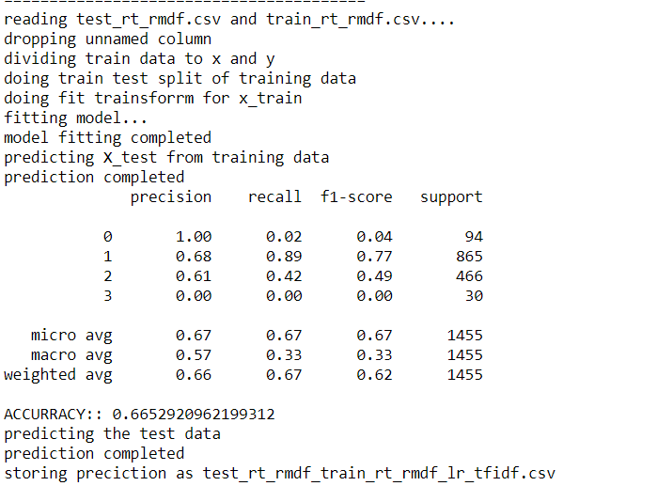
Classification report
Logistic regression, ngrams=1,3, random over sampling , count victimizer

Slide 19
Classification Report
The following additional information may result in improved performance of the model.
Retweet
Time Frame
Location
Unmasked data
Sales data to find out the effect on sales after the event.

